Slide 2


Who are we?
01
I know that I know nothing .
We are much more than a communication company.
We are professionals surrounded by professionals, planning proposals, developing strategies, and closely collaborating with our clients to achieve their/our goals.
We have over 20 years of experience thinking and creating products and brands, advising our clients with communication plans, tactics, and designed actions.
We are creative professionals eager to learn.

Slide 3


What do we offer?
02
What we do .
We offer personalized consulting for each company and every product.
We provide everything the client needs when the product or campaign requires it, from corporate image and brand applications to mobile apps and event organization.
Flyers, catalogs, merchandise, photography, infographics, web design, packaging, outdoor advertising, telemarketing, video production, and exhibition booths."

Slide 4


How do we work?
03
This is how we would like to work .
We consider four basic principles essential to ensure success:
Loyalty. Confidentiality above all.
Proximity. Presence in meetings and courses.
Punctuality. Adhering to agreed-upon deadlines.
Resolution. We solve puzzles and provide solutions.

Slide 5

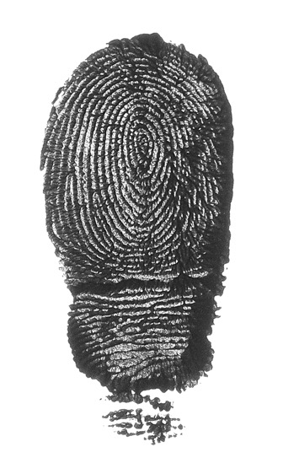
In summary…
04
What makes us unique .
We dedicate full attention to each project, from start to finish, meeting deadlines, and providing a close and straightforward approach.
Tell us what you need, and we'll provide it, find it for you, or invent it.

Slide 6
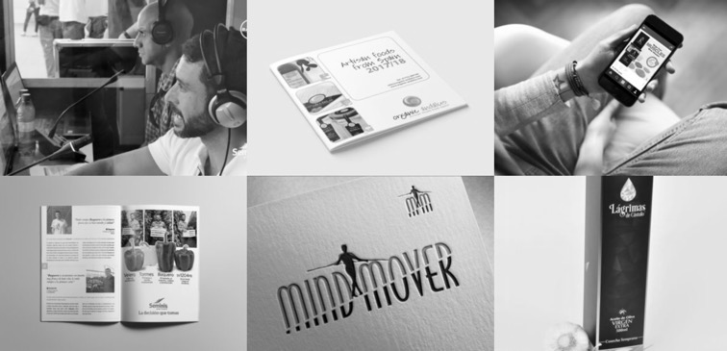
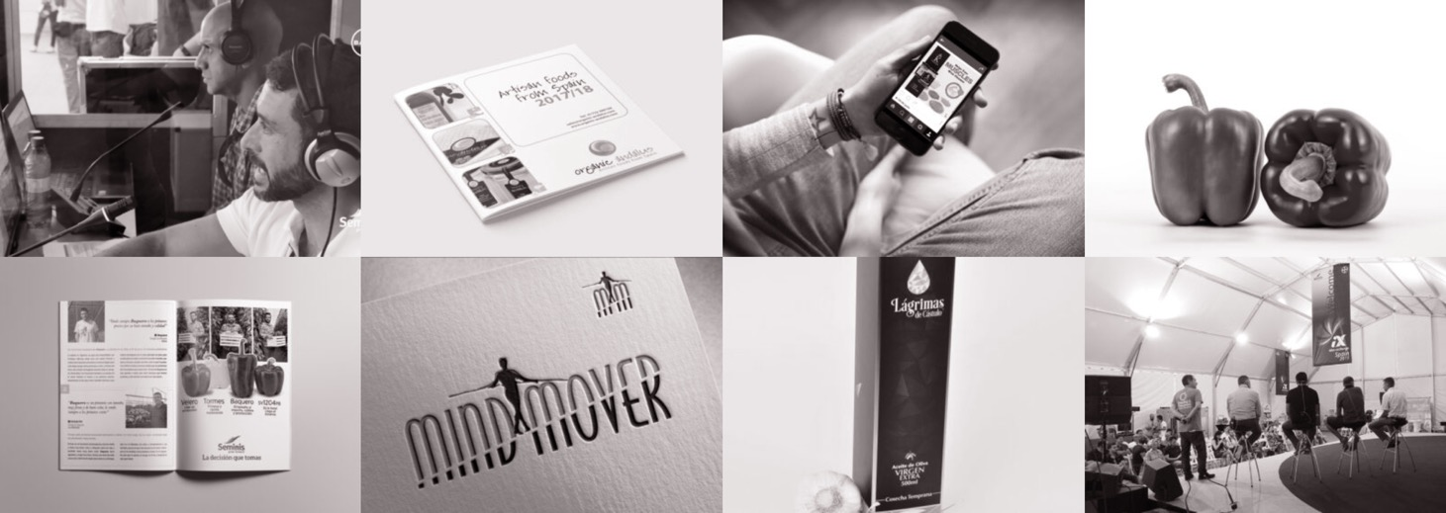
What do we do?
05
Our showroom .
Visit https://nitrogeno.net to access a more detailed showcase of our latest projects.

Slide 7
THANK YOU FOR YOUR TIME

